Slide 1
Introduction to Computer Networks
INTRODUCTION TO COMPUTER NETWORKS

Slide 2
Module:1 Networking Principles and Layered Architecture
Data Communications and Networking: A Communications Model
Data Communications –
Evolution of network,
Requirements , Applications,
Network Topology (Line configuration, Data Flow),
Protocols and Standards, Network Models (OSI, TCP/IP)

Slide 3
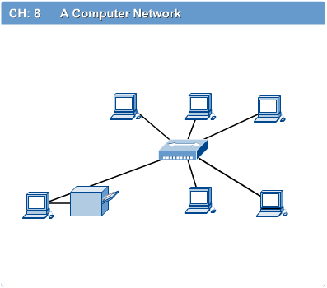
Computer Networks
Introduction to Computer Networks
Computer network connects two or more autonomous computers.
The computers can be geographically located anywhere.

Slide 4
Networking
Computer network
A collection of computing devices that are connected in various ways in order to communicate and share resources
Usually, the connections between computers in a network are made using physical wires or cables
However, some connections are wireless, using radio waves or infrared signals

Slide 5
Networking
The generic term node or host refers to any device on a network
Data transfer rate The speed with which data is moved from one place on a network to another
Data transfer rate is a key issue in computer networks

Slide 6
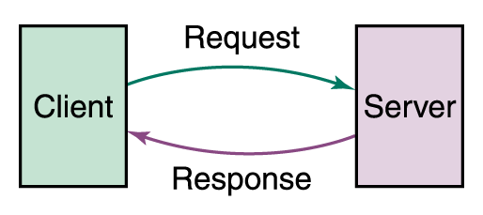
Networking
Computer networks have opened up an entire frontier in the world of computing called the client/server model
Figure 15.1 Client/Server interaction

Slide 7
Networking
File server A computer that stores and manages files for multiple users on a network
Web server A computer dedicated to responding to requests (from the browser client) for web pages

Slide 8
Applications of Networks
Introduction to Computer Networks
Resource Sharing
Hardware (computing resources, disks, printers)
Software (application software)
Information Sharing
Easy accessibility from anywhere (files, databases)
Search Capability (WWW)
Communication
Email
Message broadcast
Remote computing
Distributed processing (GRID Computing)

Slide 9
LAN, MAN & WAN
Introduction to Computer Networks
Network in small geographical Area (Room, Building or a Campus) is called LAN (Local Area Network)
Network in a City is call MAN (Metropolitan Area Network)
Network spread geographically (Country or across Globe) is called WAN (Wide Area Network)

Slide 10
Effectiveness of a data communications system
four fundamental characteristics:
Delivery
Accuracy
Timeliness
Jitter

Slide 11
Effectiveness of a data communications system
Delivery: The system must deliver data to the correct destination. Data must be received by the intended device or user and only by that device or user.
Accuracy: The system must deliver the data accurately. Data that have been altered in transmission and left uncorrected are unusable.
Timeliness. The system must deliver data in a timely manner. Data delivered late are useless.
Jitter: Jitter refers to the variation in the packet arrival time. It is the uneven delay in the delivery of audio or video packets.

Slide 12
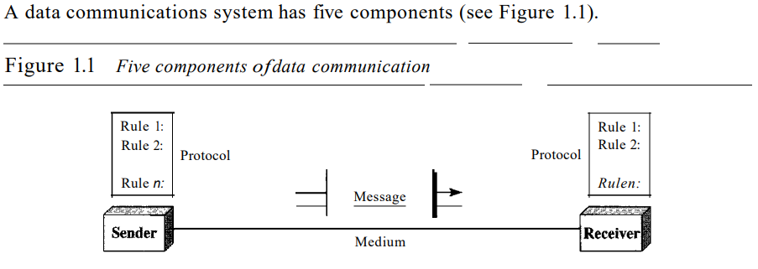
Components of a data communications system

Slide 13
Components of a data communications system
Message.
Sender.
Receiver.
Transmission medium.
Protocol.

Slide 14
Data Representation.
Text,
Numbers,
Images,
Audio, And
Video.

Slide 15
Data Flow
Communication between two devices can be
simplex,
half-duplex, or
full-duplex

Slide 16
Data Flow
Simplex: In simplex mode, the communication is unidirectional, as on a one-way street.
Only one of the two devices on a link can transmit; the other can only receive Egs:Keyboards and traditional monitors are examples of simplex devices.

Slide 17
Data Flow
half-duplex
the In half-duplex mode, each station can both transmit and receive, but not at the same time.
When one device is sending, the other can only receive, and vice versa
Eg: Walkie-talkies are half-duplex systems.

Slide 18
Data Flow
Full duplex
In full-duplex (als@ called duplex), both stations can transmit and receive simultaneously.
Eg: telephone line

Slide 19
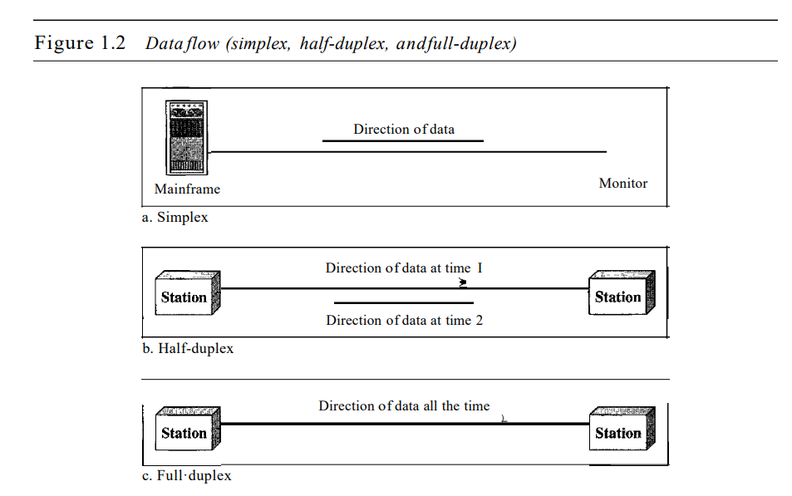
Data Flow

Slide 20
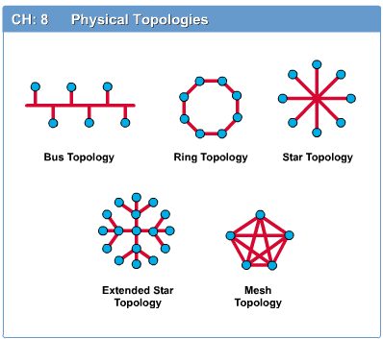
Network Topology
Introduction to Computer Networks
The network topology defines the way in which computers, printers, and other devices are connected. A network topology describes the layout of the wire and devices as well as the paths used by data transmissions.

Slide 21
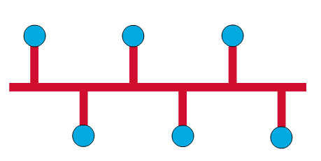
Bus Topology
Introduction to Computer Networks
Commonly referred to as a linear bus, all the devices on a bus topology are connected by one single cable.

Slide 22
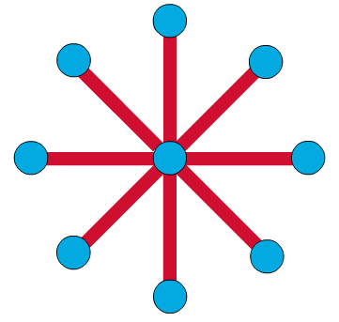
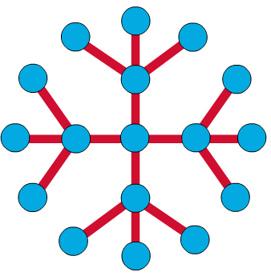
Star & Tree Topology
Introduction to Computer Networks
The star topology is the most commonly used architecture in Ethernet LANs.
When installed, the star topology resembles spokes in a bicycle wheel.
Larger networks use the extended star topology also called tree topology. When used with network devices that filter frames or packets, like bridges, switches, and routers, this topology significantly reduces the traffic on the wires by sending packets only to the wires of the destination host.

Slide 23
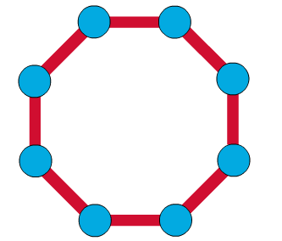
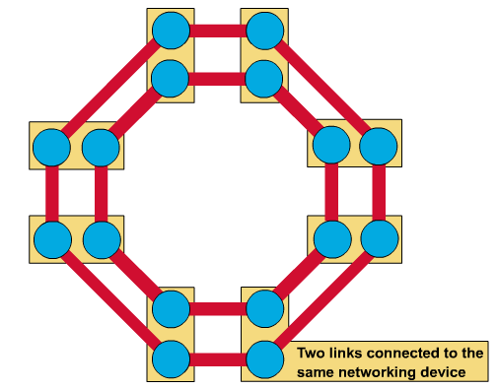
Ring Topology
Introduction to Computer Networks
A frame travels around the ring, stopping at each node. If a node wants to transmit data, it adds the data as well as the destination address to the frame.
The frame then continues around the ring until it finds the destination node, which takes the data out of the frame.
Single ring – All the devices on the network share a single cable
Dual ring – The dual ring topology allows data to be sent in both directions.

Slide 24
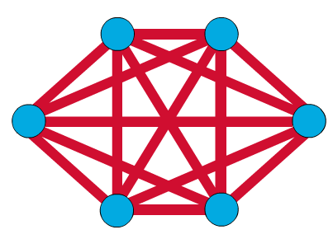
Mesh Topology
Introduction to Computer Networks
The mesh topology connects all devices (nodes) to each other for redundancy and fault tolerance.
It is used in WANs to interconnect LANs and for mission critical networks like those used by banks and financial institutions.
Implementing the mesh topology is expensive and difficult.

Slide 25
Network Components
Introduction to Computer Networks
Physical Media
Interconnecting Devices
Computers
Networking Software
Applications

Slide 26
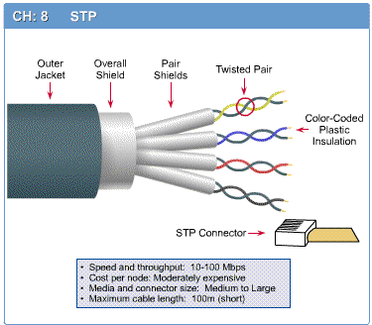
Networking Media
Introduction to Computer Networks
Networking media can be defined simply as the means by which signals (data) are sent from one computer to another (either by cable or wireless means).

Slide 27
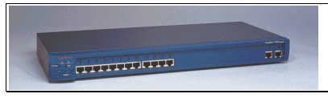
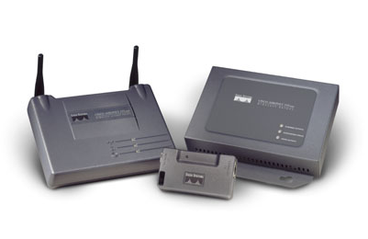
Networking Devices
Introduction to Computer Networks
HUB, Switches, Routers, Wireless Access Points, Modems etc.

Slide 28
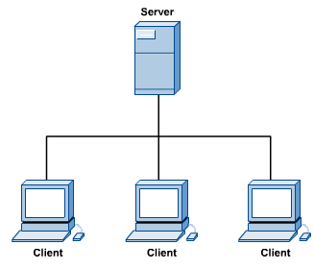
Computers: Clients and Servers
Introduction to Computer Networks
In a client/server network arrangement, network services are located in a dedicated computer whose only function is to respond to the requests of clients.
The server contains the file, print, application, security, and other services in a central computer that is continuously available to respond to client requests.

Slide 29
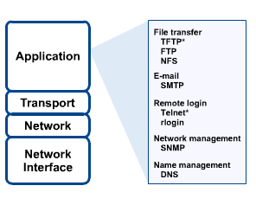
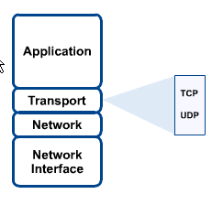
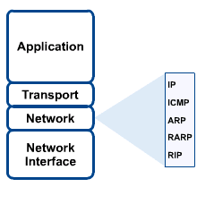
Networking Protocol: TCP/IP
Introduction to Computer Networks

Slide 30

Applications
Introduction to Computer Networks
E-mail
Searchable Data (Web Sites)
E-Commerce
News Groups
Internet Telephony (VoIP)
Video Conferencing
Chat Groups
Instant Messengers
Internet Radio

Slide 31
Four Steps to Networking
Communicating across a link
Connecting together multiple links (internetworking)
Finding and routing data to nodes on internetwork
Matching application requirements

Slide 32
A First Step
Creating a link between nodes
Link: path followed by bits
Wired or wireless
Broadcast or point-to-point (or both)
Node: any device connected to a link
Notes:
For example: Ethernet

Slide 33
Types of Links
Point-to-Point
Multiple Access
…

Slide 34
Packet Transmission Modes
Unicast
Transmission to single specific receiver
Broadcast
Transmission to all network nodes
Multicast
Transmission to specific subset of nodes
Anycast
Transmission to one of a specific subset of nodes

Slide 35
What are Switched Networks?
Switch: moves bits between links
Packet switching
Circuit switching
Switched Network

Slide 36




Back in the Old Days…

Slide 37
Then Came TDM…
Synchronous time division multiplexing
Multiplex (mux)
Demultiplex (demux)

Slide 38
TDM Logical Network View

Slide 39




Packet Switching (Internet)
Packets

Slide 40
Packet Switching
Interleave packets from different sources
Efficient: resources used on demand
Statistical multiplexing
General
Multiple types of applications
Accommodates bursty traffic
Addition of queues

Slide 41
Second Step: Internet[work]
A collection of interconnected networks
Host: network endpoints (computer, PDA, light switch, …)
Router: node that connects networks
Internet vs. internet
Internet[work]
Notes:
What if want to communicate between hosts on different Ethernets? Internet as interoperability layer

Slide 42
Challenge
Many differences between networks
Address formats
Performance – bandwidth/latency
Packet size
Loss rate/pattern/handling
Routing
How to translate between various network technologies

Slide 43
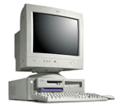
Third Step: How To Find Nodes?
Internet
Computer 1
Computer 2

